Slide 1
Presented by Ali Haider (1393127) Naveed Ahmed (1393211) Ali Raza Kharl (1390285) Group : UnitCodeMaster
Improve Unit Test (Spatial Pooler and Temporal Memory)

Slide 2
Table of Content
Abstract
Introduction
Objectives
Methods
Results
Conclusion
Reference

Slide 3
Abstract
Hierarchical temporal memory is the technique that works on the principles of neo cortex.
Spatial Pooler and Temporal Memory are the important components of HTM.
It transforms the binary input patterns into the sparse distribution representation which then acts as an input to temporal memory algorithm to make predictions.
Temporal Memory learns sequences of Sparse Distributed Representations (SDRs) formed by the Spatial Pooling algorithm and makes predictions of what the next input SDR will be.
As unit tests run to maintain code health, ensure code coverage, and find errors and faults before your customers do. Run your unit tests frequently to make sure your code is working properly

Slide 4
Introduction
Hierarchical temporal memory (HTM) is an approach to machine learning which is inspired by the neocortex. HTM tries to take advantage of brain’s neocortex problem solving procedure to, despite other machine learning techniques, be able to solve different types of problems with almost the same architecture, as the brain.
Our task is to implement new unit tests of spatial pooler and temporal memory and by start analyzing existing unit test methods.
Spatial Pooler (SP) may be a learning algorithm that's outlined to imitate the neuron's usefulness of the human brain. if a brain sees one thing at different times, it is aiming to reinforce the neural connections that respond to the input result within the recognition of the object.
The Temporal Memory algorithm does two things: it learns sequences of Sparse Distributed Representations (SDRs) formed by the Spatial Pooling algorithm, and it makes predictions.

Slide 5
Objective
In this project we have tried to developed new unit test methods of spatial pooler and temporal memory.
For the implementation of new unit test we have analyzed through existing unit test methods. Like in spatial pooler we have improved some existing tests by changing parameters values and observe the impact on active columns and cells in that active column.
In temporal memory, by taking those active columns from spatial pooler as input and predict next winner cell or best cell from bursting column

Slide 6
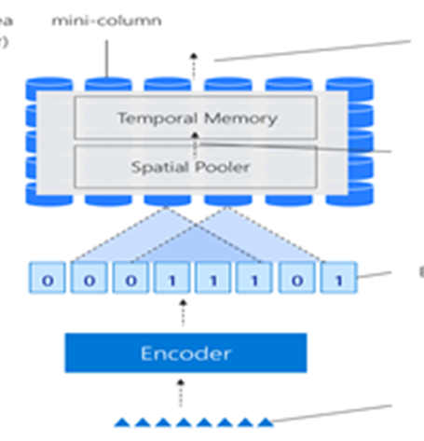
Methodology
Hierarchical Temporal Memory Cortical Learning Algorithm
-A theory and machine learning technology that aims to capture the cortical algorithm of the neocortex .
- Based on the biological functions of the brain as well as its learning mechanism.
-The results are of significant relevance and show a low percentage of errors in the predictions made over time.
Sparse Distributed Representations (SDR)
-A vast array of bits with most of them turned off (0s) and only a few turned on (1s) .
-Each SDR represents some meaning since two SDRs are judged to have equivalent meaning if they have several overlapping places on bits.
-The data is more comparable or the gap between two SDRs is smaller the more bits they share.

Slide 7
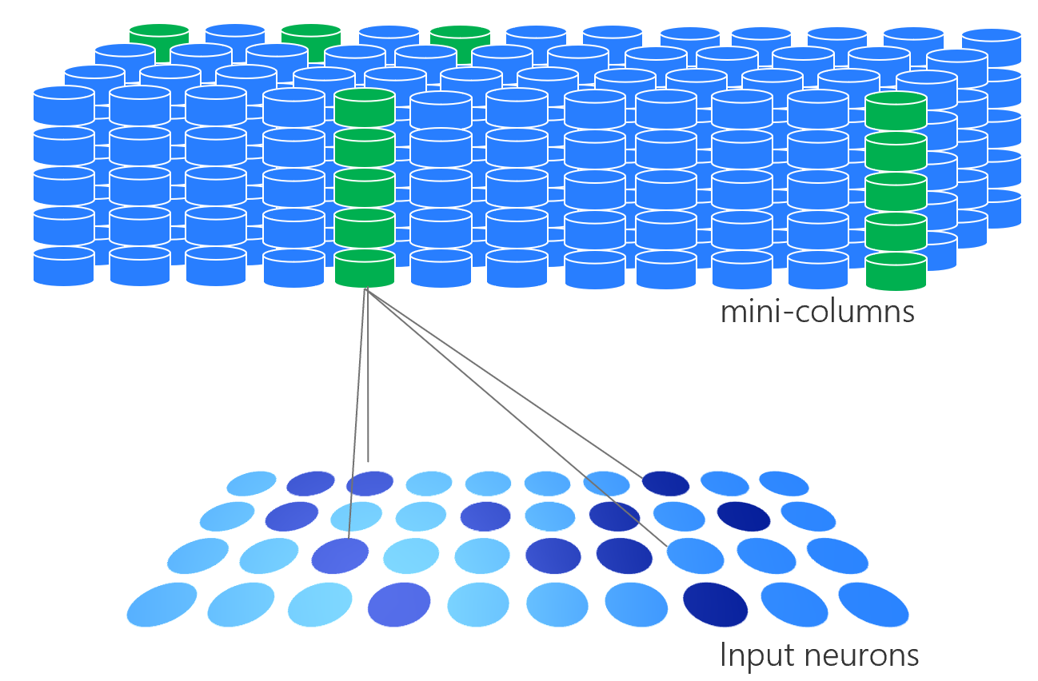
Methodology
The spatial pooler learns feed-forward connections between input bits and columns.
It acknowledges an Info or a vector of one size and changes into an output vector of different size with a sparse number of activated bits.
It keeps a decent sparsity and cross-over properties. The most principal capacity of the spatial pooler is to change over a local input to a scanty pattern.
Functionality of Spatial Pooler:
Begin with a set number of bits for your input. These bits could be sensory data, or they could come from a different part of the HTM system.
Each column has an associated dendritic segment, serving as the connection to the input space. Each dendrite segment has a set of potential synapses representing a (random) subset of the input bits

Slide 8
Methodology
The Temporal Memory algorithm starts where the Spatial Pooling algorithm leaves off, with a set of active columns representing the feed-forward input.
In the pseudocode below, a time step consists of the following computations:
Receive a set of active columns, evaluate them against predictions, and choose a set of active cells:
For each active column, check for cells in the column that have an active distal dendrite segment (i.e., cells that are in the “predictive state” from the previous time step) and activate them. If no cells have active segments, activate all the cells in the column, marking this column as “bursting”. The resulting set of active cells is the representation of the input in the context of prior input.
For each active column, learn about at least one distal segment. For every bursting column, choose a segment that had some active synapses at any permanence level. If there is no such segment, grow a new segment on the cell with the fewest segments, breaking ties randomly. On each of these learning segments, increase the permanence on every active synapse, decrease the permanence on every inactive synapse, and grow new synapses to cells that were previously active.

Slide 9
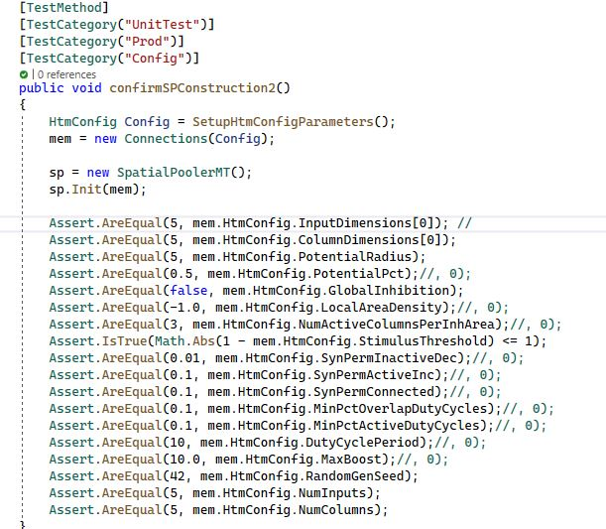
Implementation of Unit tests
Some of the tests as shown

Slide 10
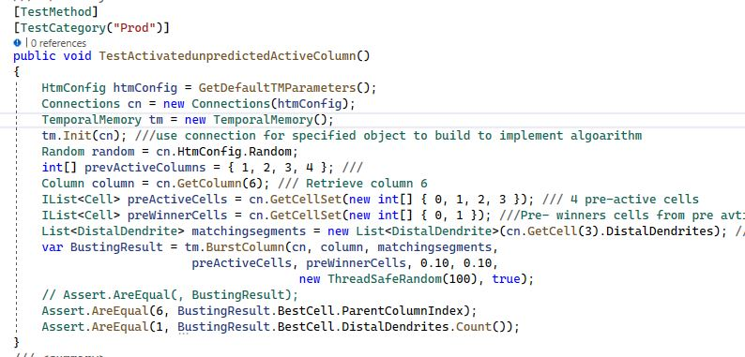
Implementation of Unit tests

Slide 11
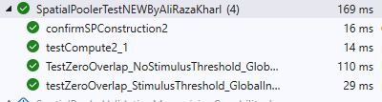
Results of Spatial Pooler Tests

Slide 12
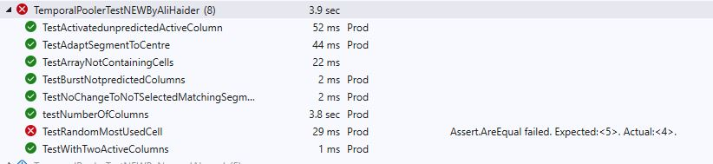
Results of Temporal Memory Unit Tests

Slide 13
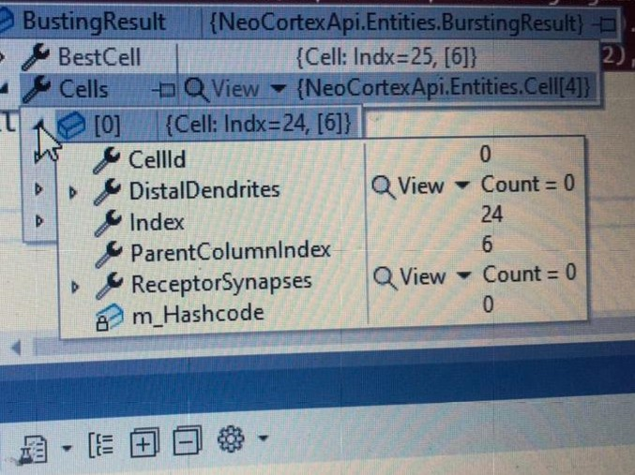
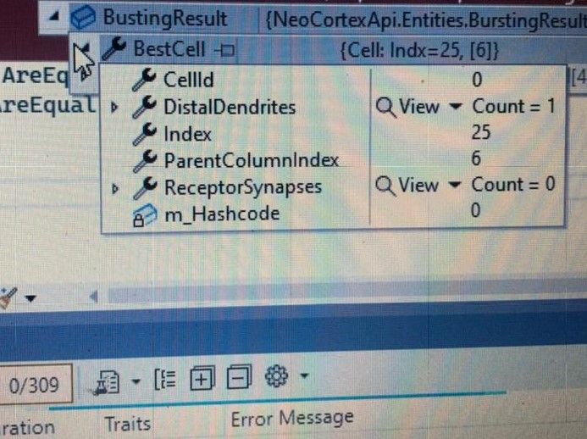
Best Cell and Parent Column Index from Bursting Column using Random function

Slide 14
Test Random Most Used Cell
We have got the most used cell in a column. In this test whenever we run the test it predicts the new values, and it lies between three values. And these expected values vary depending upon how much we choose the column dimension.

Slide 15
Conclusion
Machine intelligence has recently evolved a new paradigm in the form of spatial pooler and temporal memory theory, which represents the structural and algorithmic components of the neocortex.
Spatial Pooler and temporal memory are novel techniques in the field of machine intelligence that was developed. In this research, I aim to improve the performance of the spatial pooler and temporal memory by using public classes as a basis for their development. we proposed five-unit tests in spatial pooler and 13-unit tests in temporal memory, which we validate and benchmark against existing ones.
Using datasets from the spatial pooler and temporal memory repository. Algorithm's inference of patterns and structures that the system recognizes still needs a lot of development. Following a series of tests in which the learnt data is correlated with the input and output, agility is the goal.
The results demonstrate that the proposed unit tests can improve the performance of the spatial pooler and temporal memory and their performance is equivalent to that of other standard machine learning techniques such as the decision tree, among others. The random function cannot be handled easily but can be managed at a small real because units test can handle it easily My future research will focus on further enhancing the algorithm design and investigating the application of the spatial pooler and temporal memory for mathematical issues, among other things. In the realm of machine learning, Deep Learning is a vital component of the use of Artificial Intelligence.

Slide 16
References
[1] Ahmad, S., and Hawkins, J. (2016). How do neurons operate on sparse distributed representations? A mathematical theory of sparsity, neurons and active dendrites. arXiv arXiv:1601.00720 [q-NC].
[2] Hawkins, J., Ahmad, S., and Dubinsky, D. (2011). Cortical learning algorithm and hierarchical temporal memory. Numenta Whitepaper, 1– 68.available.online.at: http://numenta.org/resources/HTM_CorticalLearningAlgorithms.pdf
[3] S. Ahmad, M. Lewis and C. Lai, Temporal Memory Algorithm, pp. 1-12.
[4] [Online]. Available: https://github.com/ddobric/neocortexapi/tree/master/docs/images

